Slide 1





Felicia.Orr@tn.gov
615-390-4461
tnpromise
collegefortn.org

Slide 2
FAFSA Basics & Changes

Slide 3
2024-25 FAFSA
Available December 2023 at studentaid.gov
    2022 income/tax info
Arlington’s priority deadline February 1, 2024
Create FSA ID(s) ten days in advance of FAFSA
  studentaid.gov; 800-433-3243
Role-based FAFSA
Notes:
First, it will be open at some point this December. Second, Tennessee’s priority deadline will be April 15. Third, anyone working on the FAFSA will now need a username/password to complete their part. Fourth, the student will complete their part of the FAFSA…

Slide 4
FAFSA Checklist
Student Social Security number
Student FSA ID username/password
Parent(s) Social Security number(s)
Parent(s) FSA ID username(s)/password(s)
Student’s driver’s license number if you have one
2022 tax information (including 2022 W-2, Schedule 1, and Schedule K-1 forms) for student and parent(s)
Records of your untaxed income, such as child support
Checking and savings (e.g. Money Market, CDs, etc.) account balances

Slide 5
FSA ID for Everyone
Parent without SSN must now create FSA ID to be authenticated via Transunion
Each parent may have to create FSA ID + student
Forgot parent login?
  Retrieve/reset at studentaid.gov
  Unable to retrieve/reset, call 800-433-3243 before January

Slide 6
Parents w/o SSNs
Which of the following is the street name of your most recent previous address?
Which of these phone numbers have you ever used?
Which of the following is a current or previous employee?
Knowledge-based questions for parents without SSNs will be posed after two-step verification screen.

Slide 7
Parents w/o SSNs
Two pathways upon answering knowledge-based questions…
Account created; your identity has been verified
  FSA ID can be used immediately
Account created but you need to contact us
  User must call FAFSA at 800-433-3243 to confirm their identity.

Slide 8
Proofing Documents
Driver’s License
State or City ID Card
Foreign Passport
Utility Bill + ONE of the following
  Municipal ID Card
  Community ID
  Consular ID Card

Slide 9
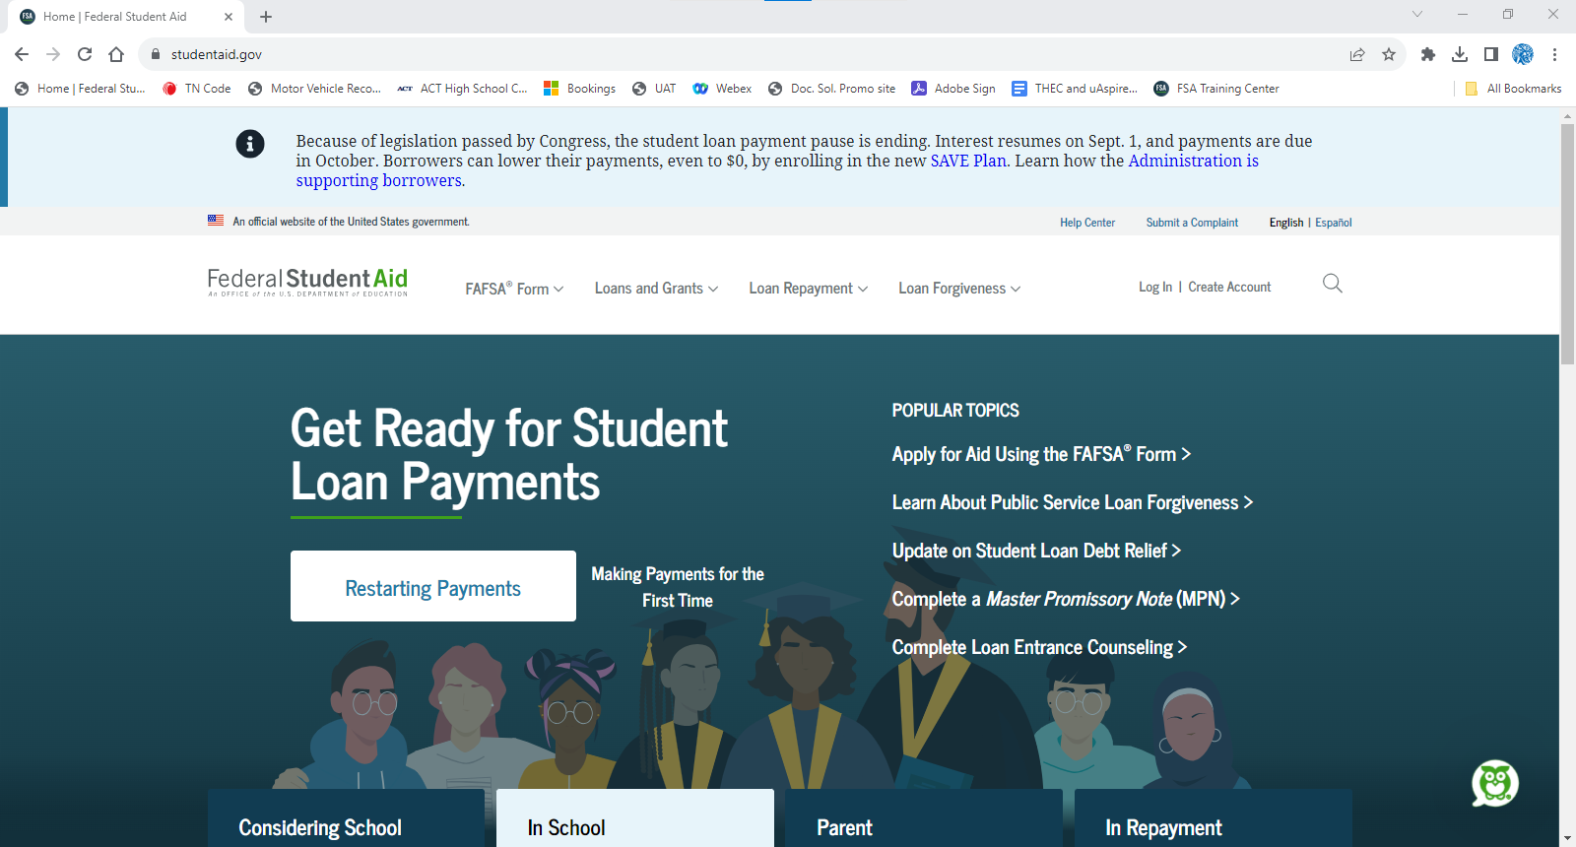
Create FSA ID at least 3 days prior to completing the FAFSA.
studentaid.gov
Notes:
To create a FSA ID, go to studentaid.gov, and click create account. [click]

Slide 10
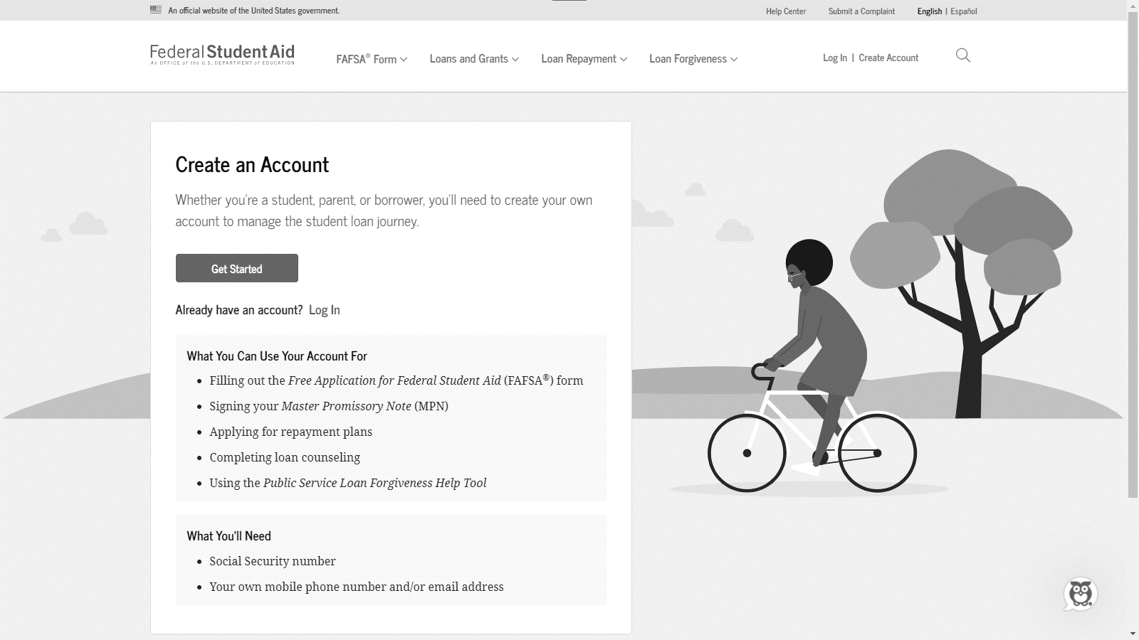
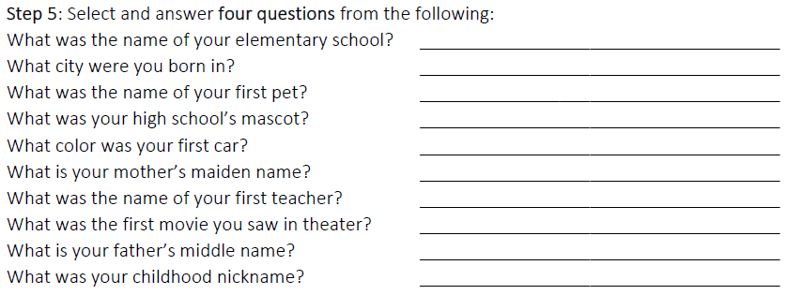
10-minute creation warning!!! Select & answer four challenge ?s before you get started.
Nashville
Tiger
Smith
John
Notes:
The FSA ID creation process tends to timeout after 10 minutes, so before you begin, on a sheet of paper, write down answers to four of these questions.

Slide 11
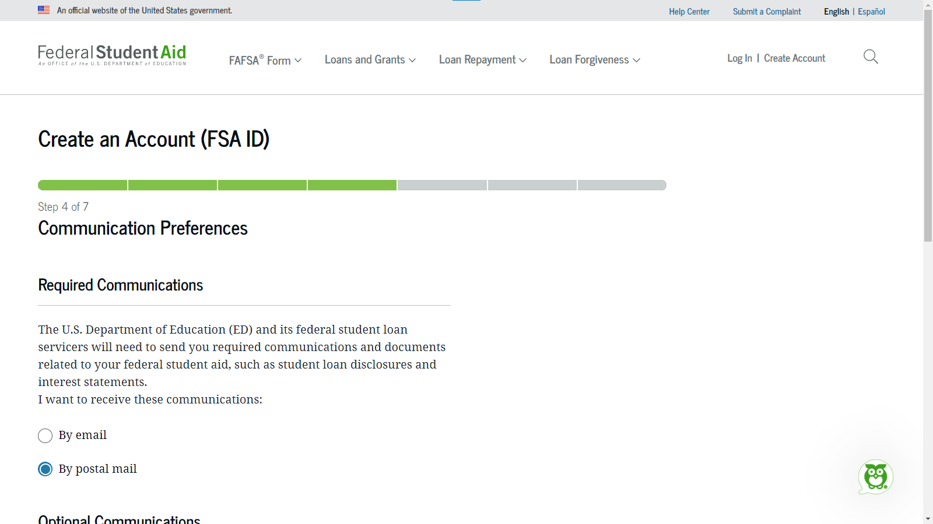
Notes:
Step 4, select your communication preferences… [click]

Slide 12
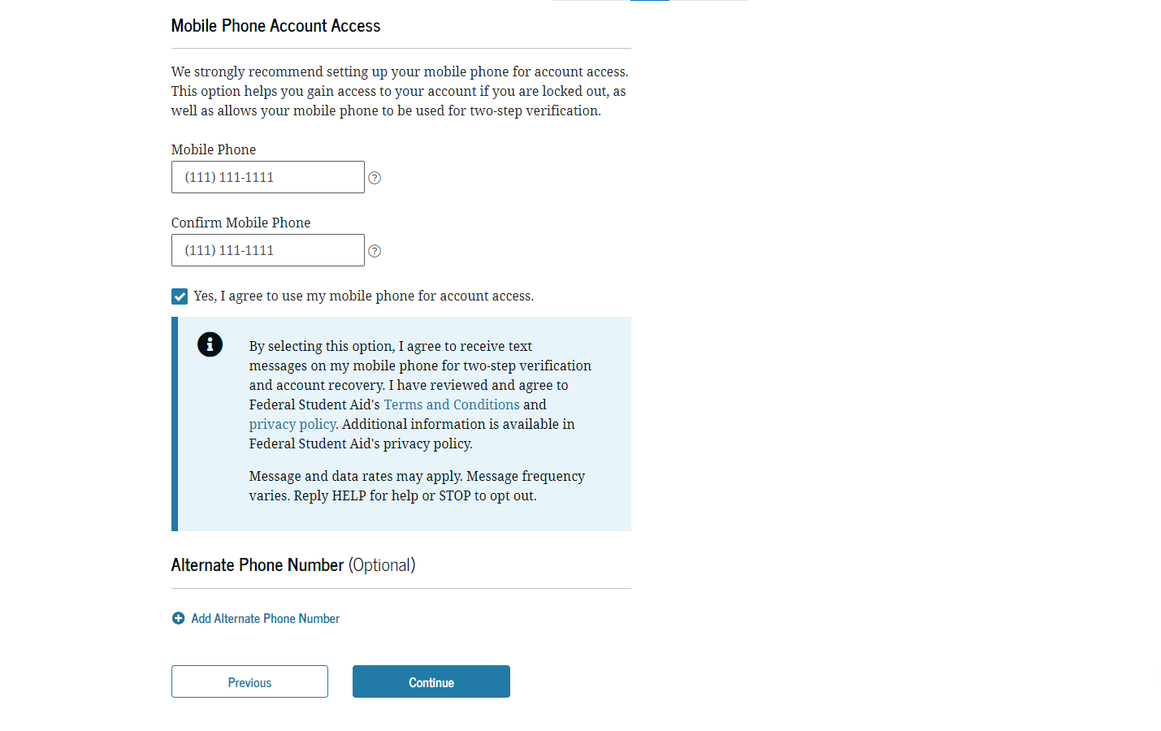
Notes:
Next, enter and reenter your mobile number and click the box to use your mobile number for account access. Click continue. [click]

Slide 13
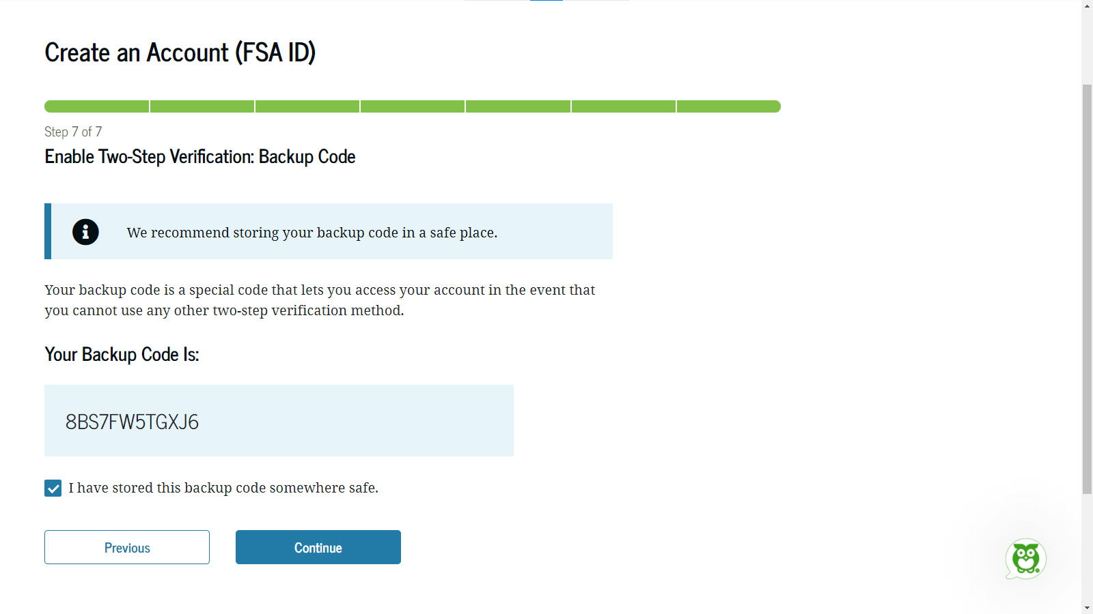
Notes:
Take a picture or write down your backup code, check the box, and click continue. [click]

Slide 14
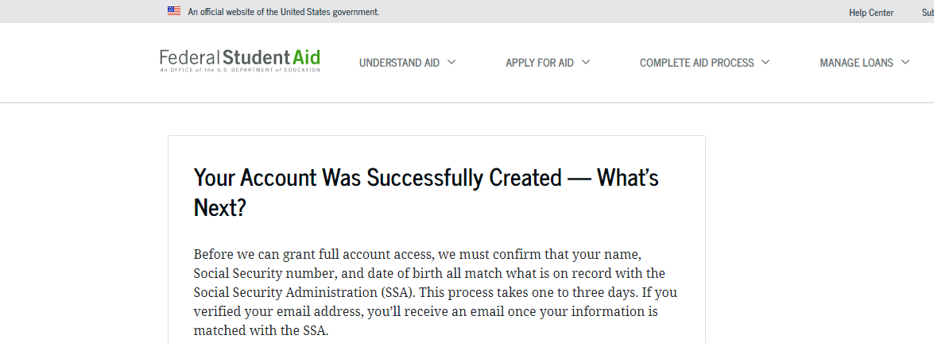
FSA ID authentication for parents with ITINs/no SSNs may take up to 10 days.
Notes:
Your account has been successfully created. The Social Security Administration must confirm your information which takes up to 3 days. Once confirmed, you should receive an email that you can use your username/password to complete the 24-25 FAFSA. [click]

Slide 15
FSA ID = Username/Password
Parent 1
Parent 2*
FSA IDs needed for a dependent student completing the 2024-25 FAFSA…
Student
✓
✓
✓
*Required if married to parent 1 and filed 2022 taxes separately.
Notes:
The 24-25 FAFSA will require all users to login with their username/password which is known as the FSA ID. A dependent student completing the FAFSA will need an FSA ID as well as one parent. In some scenarios, the second parent will also need an FSA ID.

Slide 16
Role-based FAFSA
Student will complete/submit a student section
Parent(s) will complete/submit a parent section(s)
  No order of operation
  Student/parent(s) will identify one another by name/SSN to connect sections
  45-day expiration

Slide 17
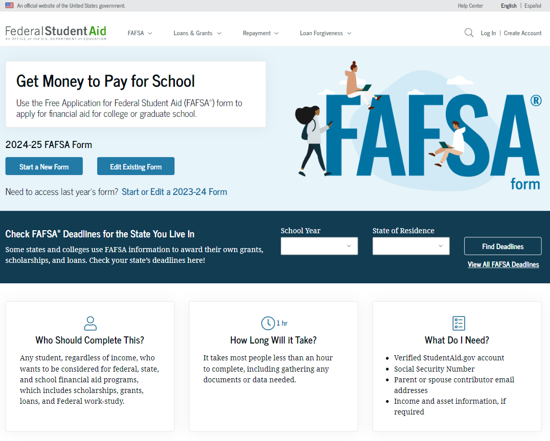
Need to start/edit 2023-24 FAFSA, click here.
Notes:
When updates are implemented, fafsa.gov will be dedicated to the 24-25 FAFSA. Students will click start a new form to begin. Note, if a student still needs to submit or correct their 23-24 FAFSA, they can click start or edit a 23-24 form. [click]

Slide 18
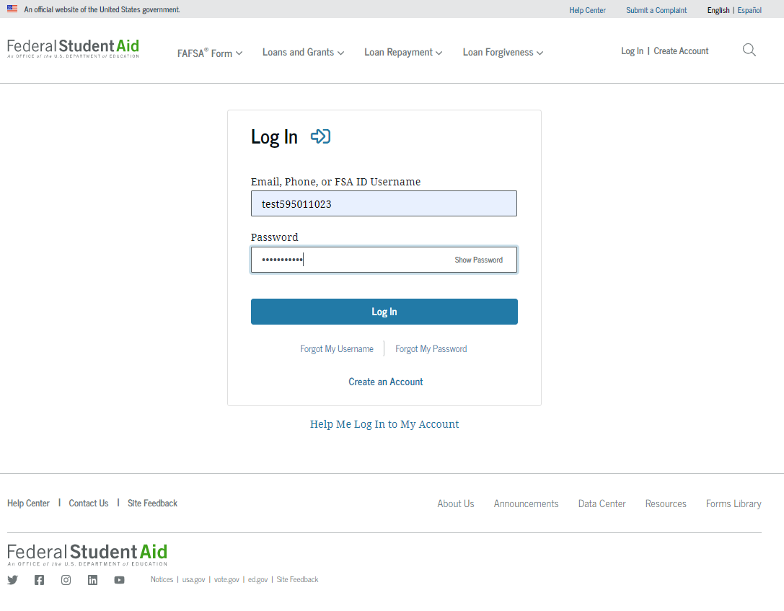
Notes:
The 24-25 FAFSA will now require the student or parent to login with their FSA ID username and password to begin. [click]

Slide 19
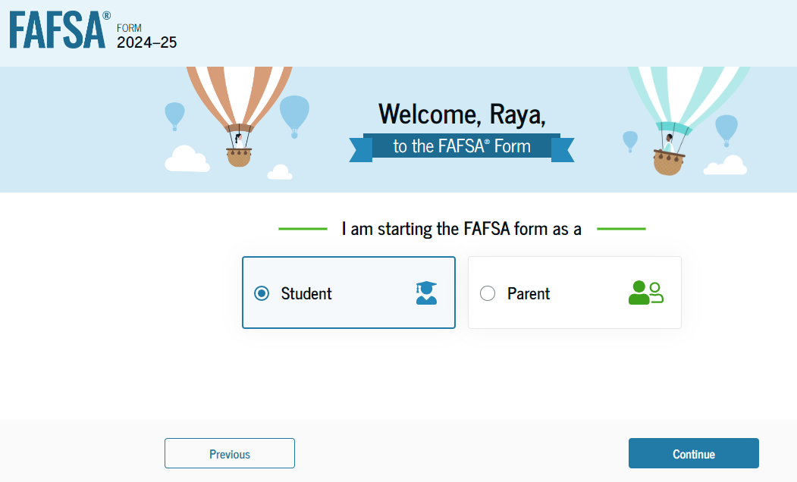
Notes:
The user will select their role to continue. Hereafter, we will explore the 24-25 FAFSA as the student. [click]

Slide 20
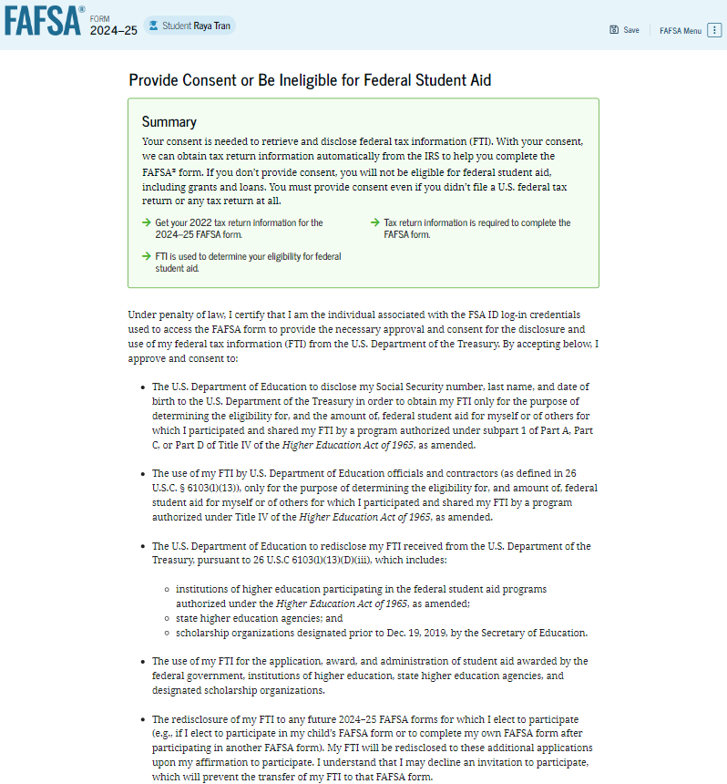
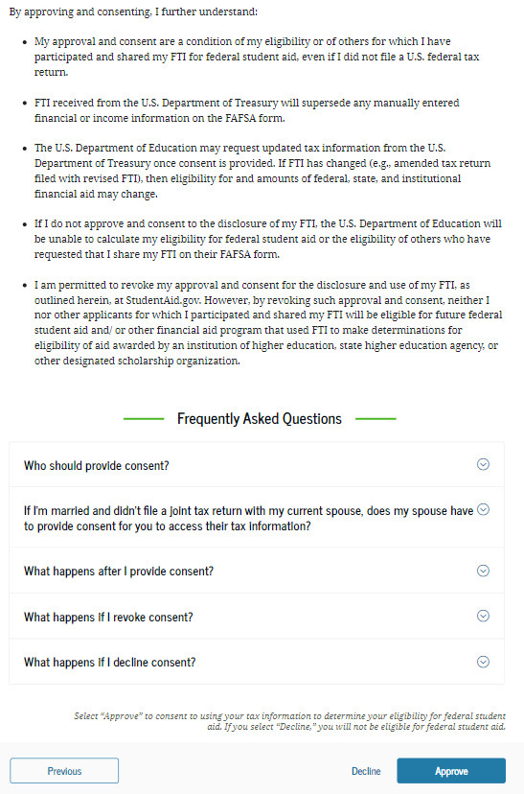
Notes:
This is a new screen. The student will have to agree to provide their consent to allow FAFSA to connect with the IRS. If consent is not provided, then the student will not qualify for federal or state aid.

Slide 21
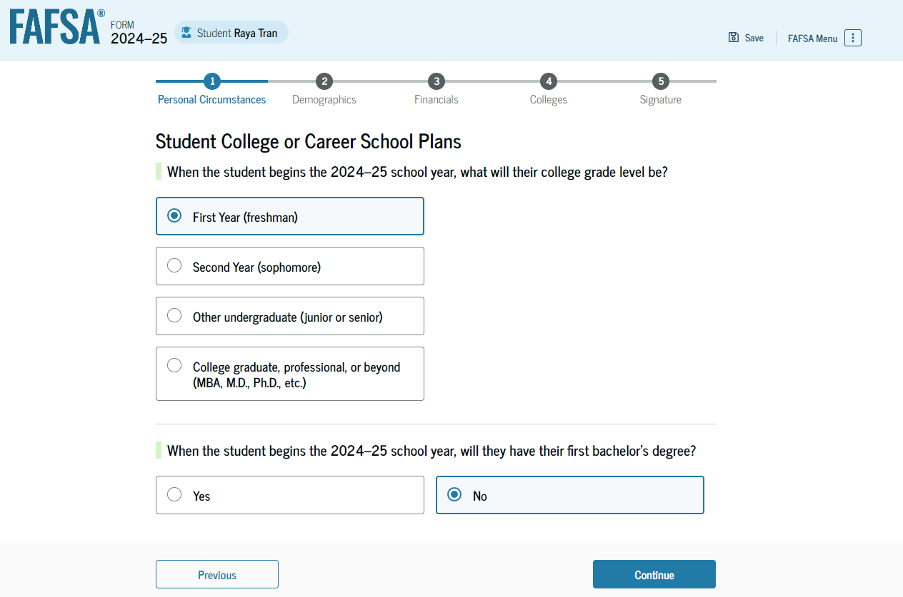
Notes:
When you begin the 24-25 school year, what will your college grade level be; next will you have your first bachelor’s degree?

Slide 22
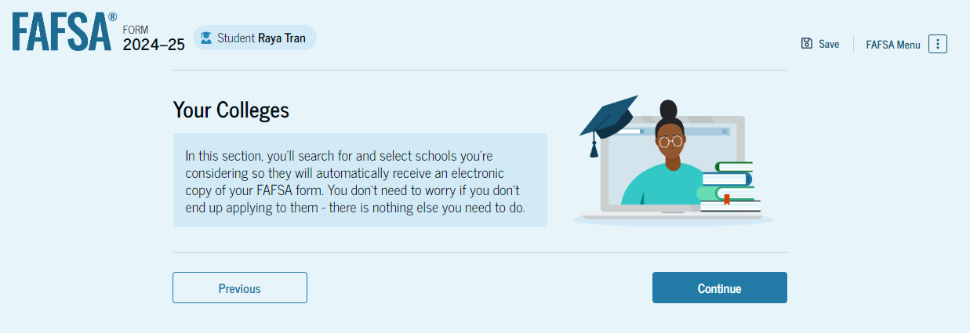
Notes:
Onto the student’s colleges section where students can now send their FAFSA to up to 20 colleges.

Slide 23
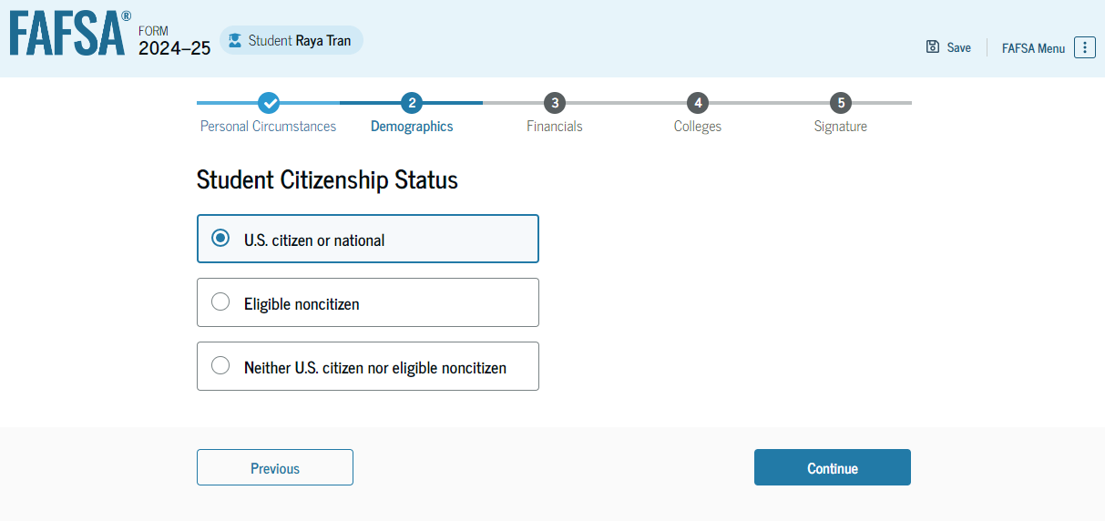
Parents without SSNs
Is the student an eligible noncitizen?
Notes:
If the student is a US citizen, select “US citizen.” If the student is a green card holder, select “eligible noncitizen.” They will then be prompted to enter your Alien Registration Number which is the USCIS# on their green card. [click]

Slide 24
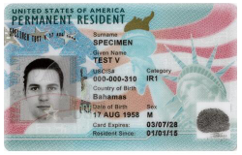
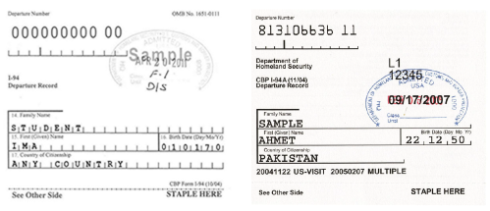
I am an eligible noncitizen
U.S. permanent residents
Individuals with an I-94 showing:
Refugee, Asylee, Cuban-Haitian
Entrant, or Parolee
Victims of human trafficking
(T-Visa)
Battered immigrants and children

Slide 25
Neither citizen nor eligible noncitizen
Holders of nonimmigrant visas (e.g. student, work, tourist)
Individuals with Temporary Protected Status (TPS)
Deferred Action for Childhood Arrivals (DACA) recipients

Slide 26
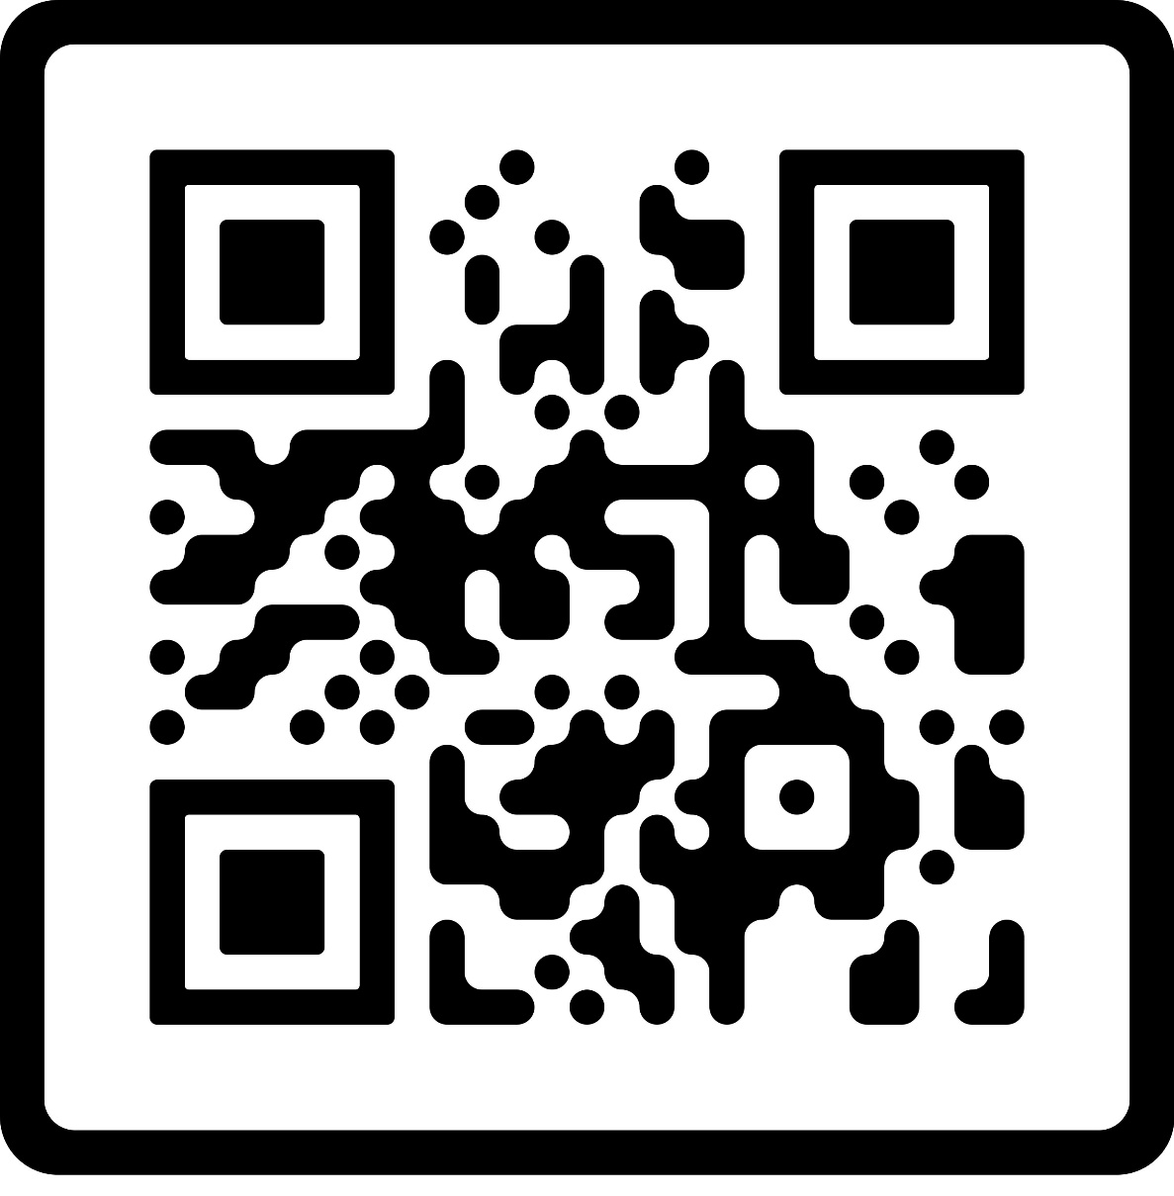
Education Trust Resources

Slide 27
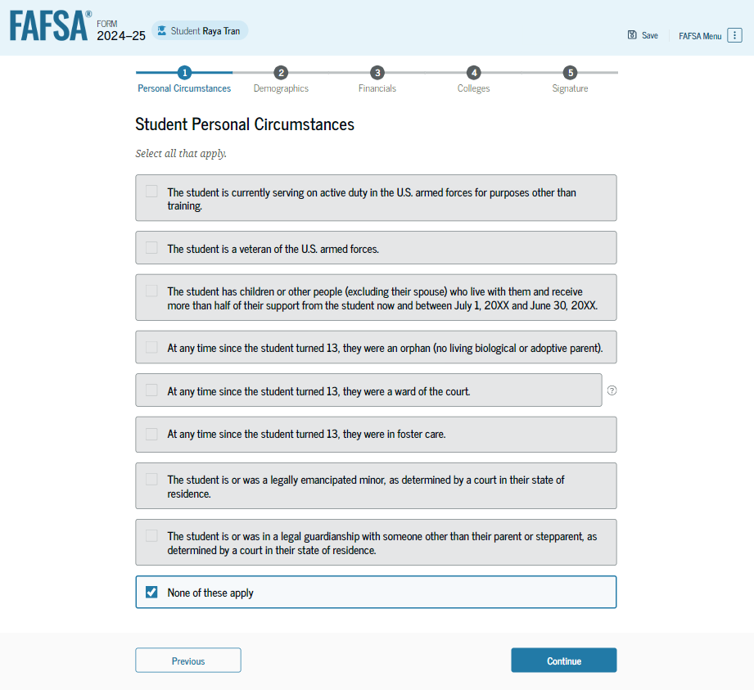
Parents without SSNs
Is the student dependent or independent?
Notes:
Review the following circumstances and select any that apply. If none, select none of these apply and click continue. [click]

Slide 28
“Adult” Circumstances
Age 24?
Married?
Working on master’s/doctorate?
Military veteran/currently serving?
Have children you financially support?

Slide 29
“Minor” Circumstances
Emancipated minor?
Have court-ordered legal guardian*?
Since age 13 – were an orphan, were in foster care, or were a ward of the court?
*If court papers read custody instead of guardianship, student will answer no and contact their college for guidance (e.g. unusual circumstance).

Slide 30
Homeless Circumstance
Homeless/ Unaccompanied Youth?
*High School Student should have proof for the current academic year from a recognized McKinney-Vento practitioner.

Slide 31
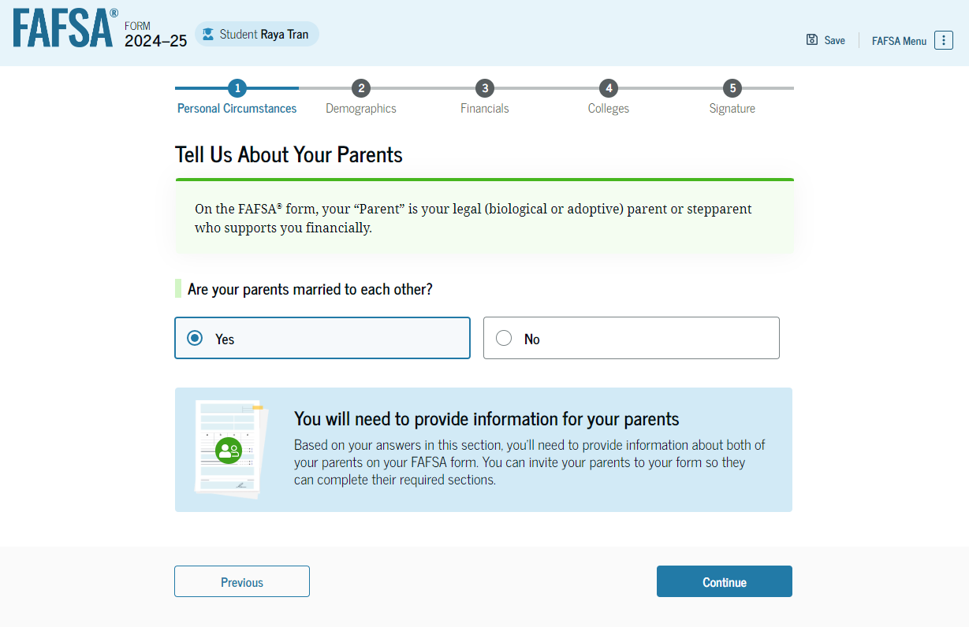
Parents without SSNs
Who is a FAFSA parent?
Notes:
This is a new screen for dependent students. Tell us about your parents. If parents are married to one another, select yes. If not, then the student will be posed more questions to determine which parent’s information to provide. Such screenshots are not available yet.

Slide 32
FAFSA parent(s)
Biological parent
Stepparent
  If married to biological parent
Adoptive parent
  Unless student was in foster care at age 13+

Slide 33
Who is NOT a FAFSA parent*?
Grandparent
Aunt/Uncle
Brother/Sister
Legal Guardian
Relative whom claimed the student for tax purposes
*Unless they have adopted the student

Slide 34
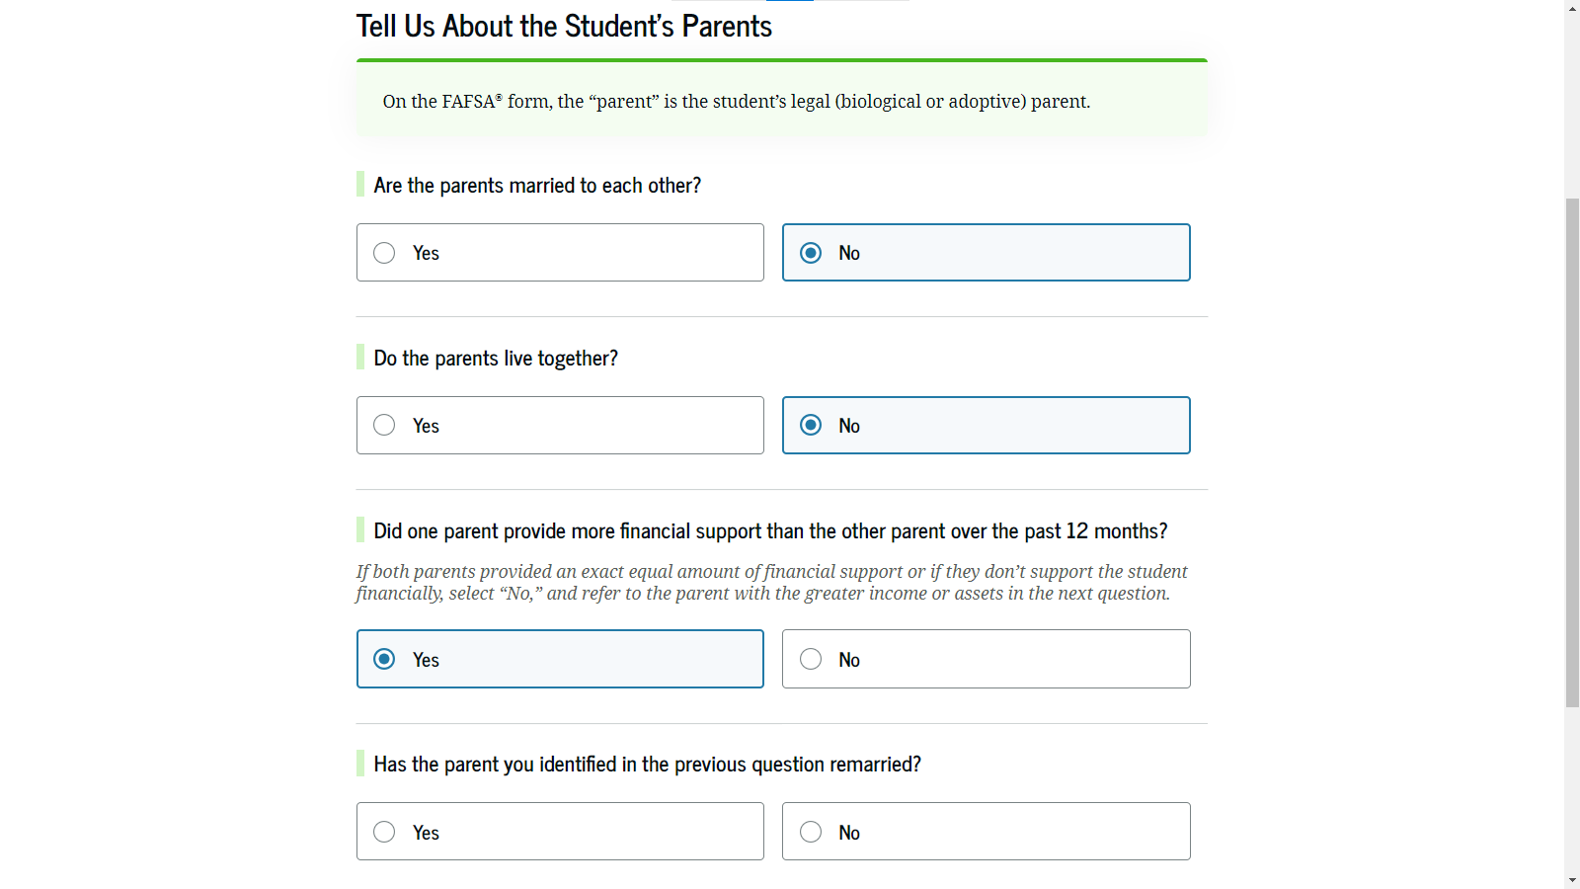
Parents without SSNs
Parents divorced or separated; which parent provided more financial support?
If parent is remarried, then FAFSA will also need stepparent’s info.
Notes:
Onto the student’s finances section. If the student filed taxes in 2022, the new IRS direct data exchange will automatically answer a few questions. If unable, then FAFSA will pose the typical income questions. Unfortunately, not all screenshots are available.

Slide 35
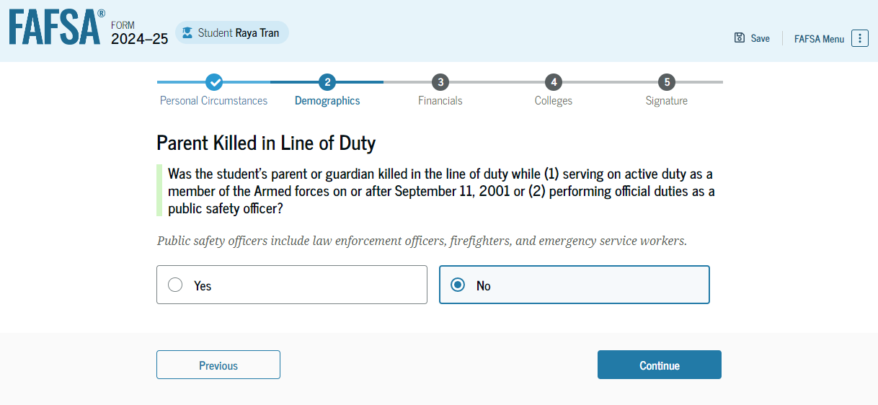
Notes:
This is a new question. Was a parent killed in the line of duty on or after 9/11 or while performing official duties as a police officer, firefighter, or emergency service worker?

Slide 36
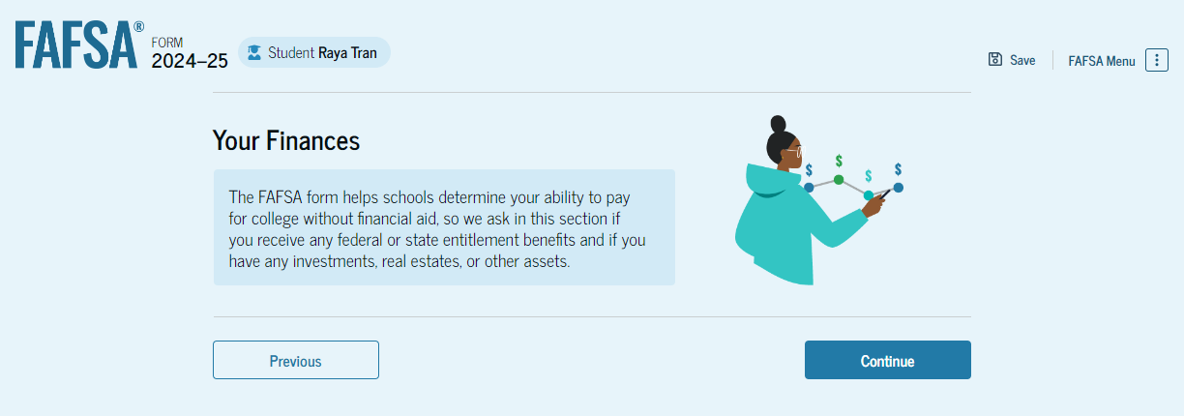
Parents without SSNs
When must someone file taxes?
Notes:
Onto the student’s finances section. If the student filed taxes in 2022, the new IRS direct data exchange will automatically answer a few questions. If unable, then FAFSA will pose the typical income questions. Unfortunately, not all screenshots are available.

Slide 37
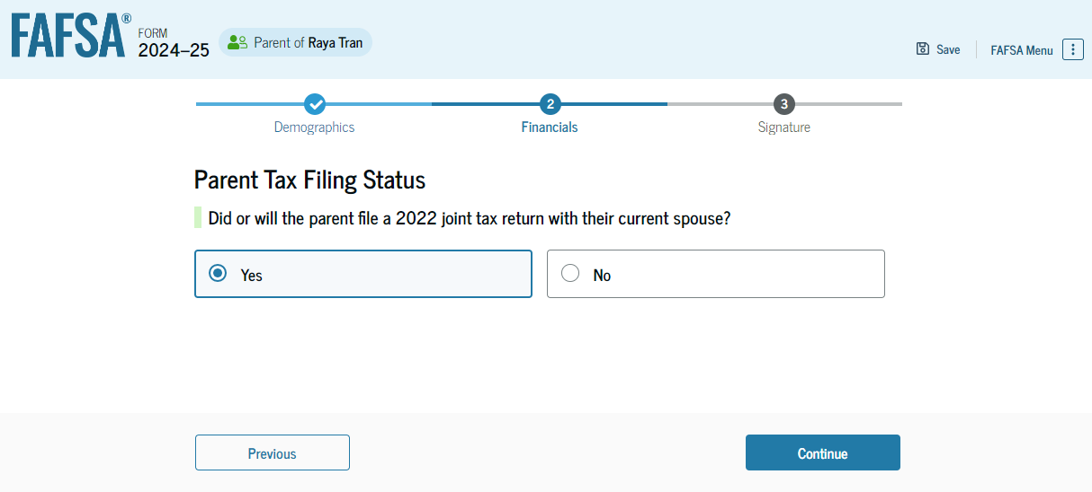
If married parents filed 2022 taxes separately, then parent 2 must complete a separate FAFSA parent section.
Notes:
Did the parent file a joint tax return in 2022 with their spouse? Married parents who filed jointly will only have to complete one parent section. However, if married parents filed separately in 2022, then the parent’s spouse must complete a separate parent section of the FAFSA.

Slide 38
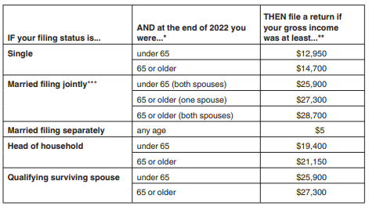
2022 IRS Filing Requirements

Slide 39
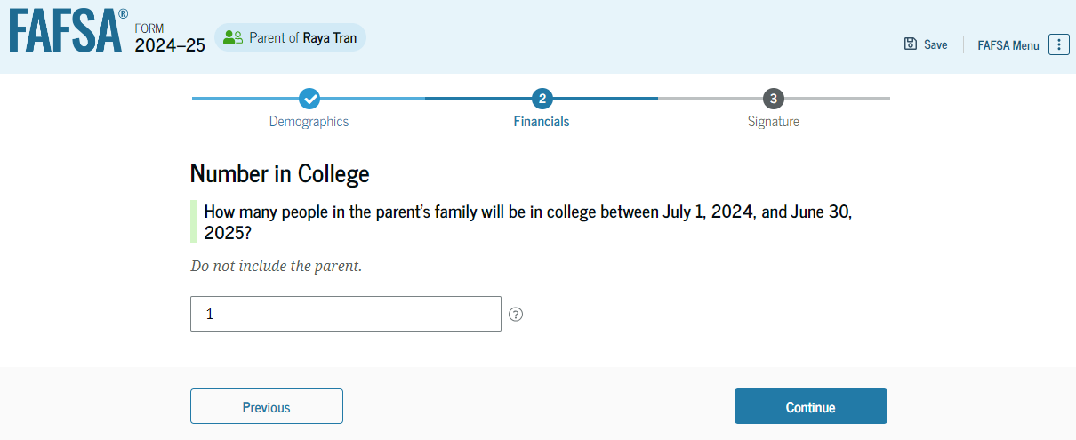
Notes:
How many people in the parents family meaning their children will be in college between July 1 and June 30?

Slide 40
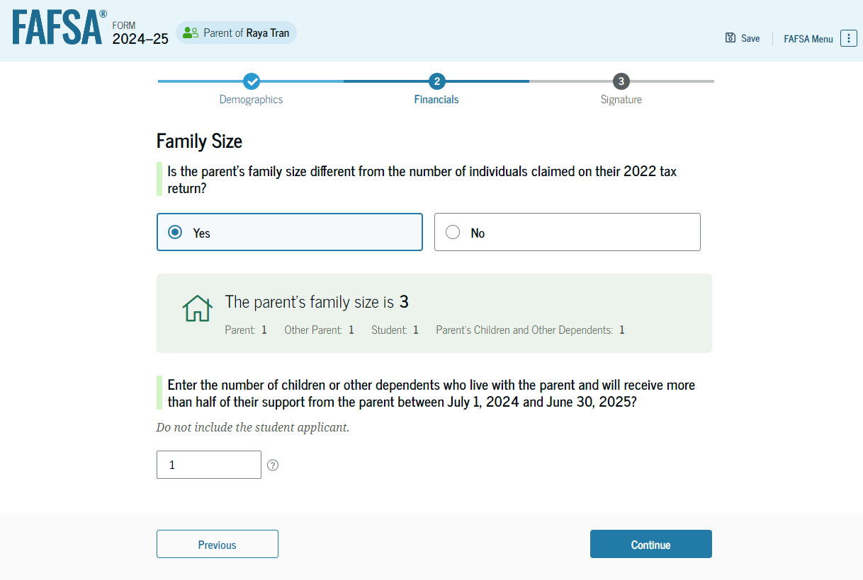
Notes:
Is the parents family size different from the number claimed on their 2022 tax return? Answer accordingly.

Slide 41
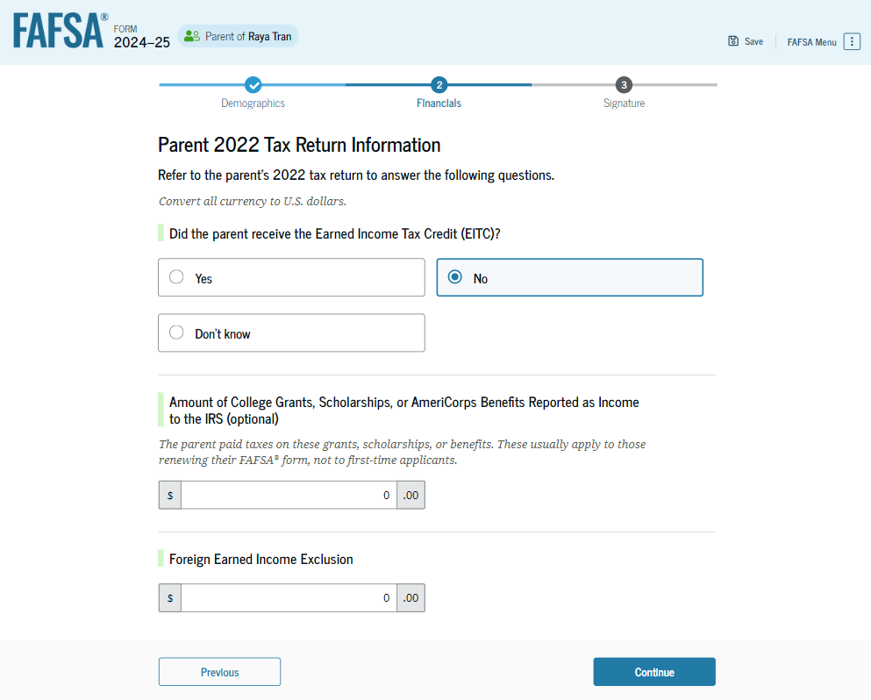
Notes:
The parent will answer the remaining questions accordingly. If a question does not apply, enter zero. [click]

Slide 42
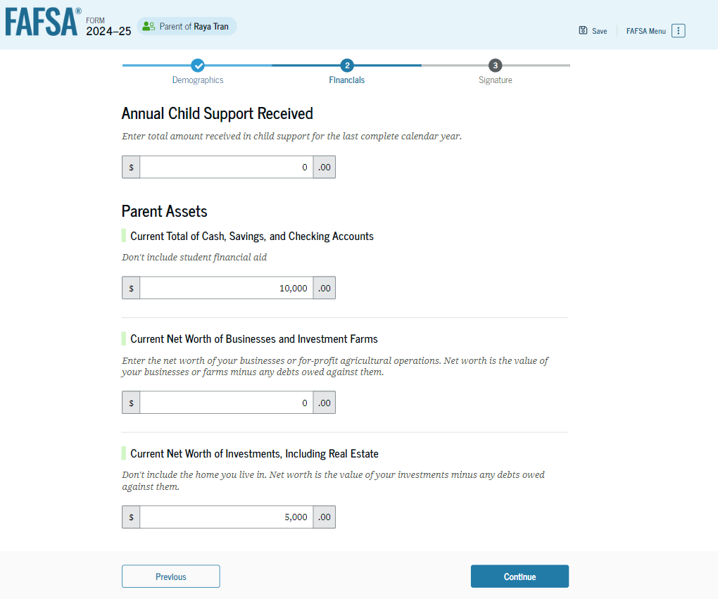
Assets will be skipped if parent(s) AGI is less than $60,000 or received a federal means-tested benefit.
Notes:
The parent will next answer child support received and their asset questions accordingly. If a question does not apply, enter zero. [click]

Slide 43
FAFSA Assets
Considered
Family farm
Small business
Money Market Funds, Mutual Funds, CDs
Stocks, stock options, bonds
529 college savings plans
(parent asset)
Rental property
NOT considered
Value of life insurance
401[k] plans
Pension funds
Annuities
Non-education IRAs
Notes:
Here is an overview of what FAFSA considers an asset and what it does not. Beginning with the 24-25 FAFSA, values of a farm and small business are now considered assets. [click]

Slide 44
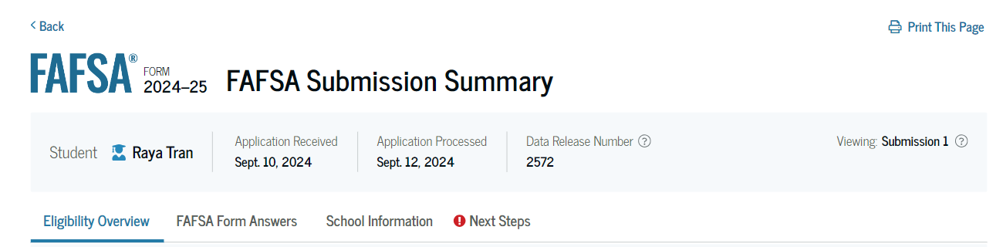
3-5 days

Slide 45
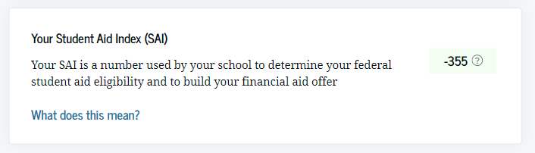

Slide 46
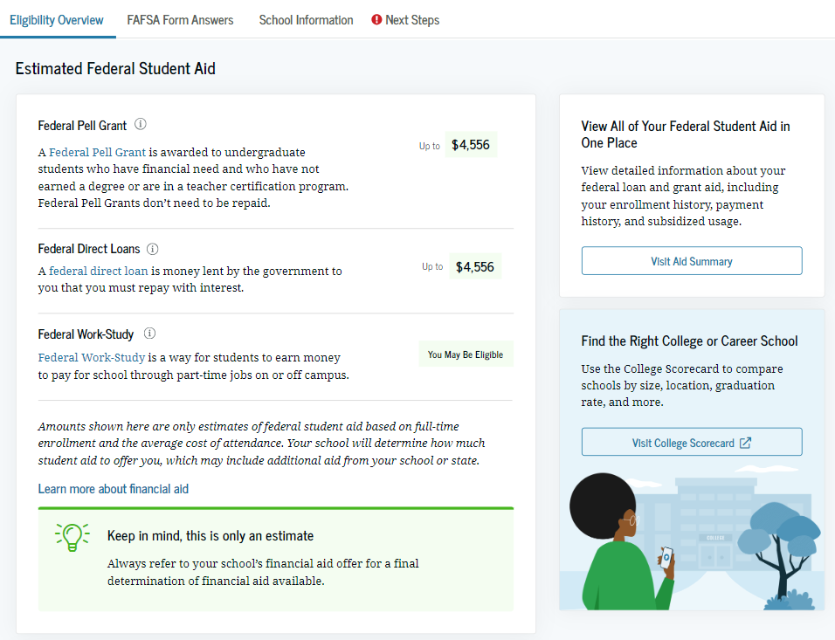

Slide 47
Federal Student Aid
Subsidized Student
5.50% fixed (2023-24)
Interest does not accrue initially
Unsubsidized Student
5.50% fixed (2023-24)
Interest does accrue
Parent PLUS
8.05% fixed (2023-24)
Interest does accrue
Pell Grant
Financial need per FAFSA*
$3,697 per semester max (2023-24)
Grant
*Student Aid Index (SAI)
Loan

Slide 48
TN Promise Checklist
Apply to the Tennessee Promise program tnpromise.gov by November 1, 2023
Complete 2024-25 FAFSA at studentaid.gov by April 15, 2024
Attend/watch mandatory meeting as coordinated by partnering organization
Complete and submit 8 hours of community service by July 1, 2024 (coordinated by partnering organization)
*Promise allows students to attend a community college
or TCAT tuition-free through a last dollar scholarship.

Slide 49
TN Community College
HOPE Scholarship
Aspire
^{HOPE Supplement}
21 ACT/SAT or 3.0 GPA
$1,600 per semester
Parents AGI ≤$36,000
+$250 per semester
GAMS
^{HOPE Supplement}
29 ACT/SAT & 3.75 GPA
+$500 per semester
Need
* ACT Superscores and ACT Residual exams cannot be used
Merit

Slide 50
TCAT
Wilder- Naifeh*
Certificate/
Diploma TCAT
$667 per trimester
*If a student is HOPE eligible upon graduation, enrolls at a TCAT
initially after high school and completes a diploma program, student may still receive HOPE by enrolling at a 2- or 4-year college within 3 years of diploma completion.

Slide 51
TN 4-yr Public
HOPE Scholarship
21 ACT/SAT or 3.0 GPA
$2,250/$2,850 per semester
Aspire
^{HOPE Supplement}
Parents AGI ≤$36,000
+$750 per semester
GAMS
^{HOPE Supplement}
29 ACT/SAT & 3.75 GPA
+$500 per semester
Need
* ACT Superscores and ACT Residual exams cannot be used
Merit

Slide 52
TN 4-yr Private
HOPE Scholarship
21 ACT/SAT or 3.0 GPA
$2,250/$2,850 per semester
Aspire
^{HOPE Supplement}
Parents AGI ≤$36,000
+$750 per semester
GAMS
^{HOPE Supplement}
29 ACT/SAT & 3.75 GPA
+$500 per semester
Need
* ACT Superscores and ACT Residual exams cannot be used
Merit

Slide 53
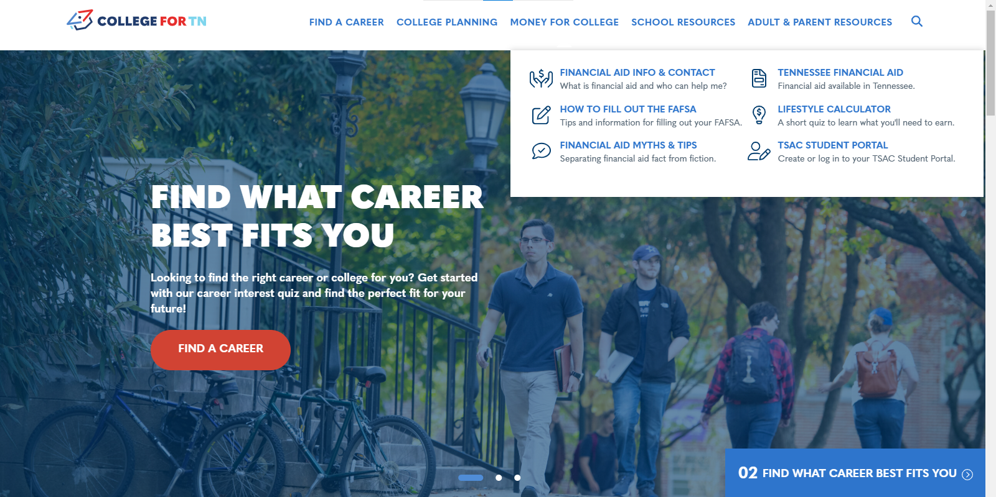
Notes:
This concludes part 6 of the 24-25 FAFSA preview. For more information about the FAFSA and our state aid programs, check out money for college at collegefortn.org.

Slide 54
Felicia.Orr@tn.gov
615-390-4461
tnpromise
collegefortn.org

